Slide 1

27 June - Machine Vision feat. TensorFlow
Notes:
NETWK_O.POT

Slide 2

Acknowledgement of Country
I’d like to begin by acknowledging the Traditional Owners of the land on which we meet today. I would also like to pay my respects to Elders past and present.

Slide 3

Overview
What is Machine Vision?
What is TensorFlow?
Implementing Tensorflow Object Detection from your Webcam Theory + Project

Slide 4
Machine Vision

Slide 5


What is Machine Vision?
Machine Vision teaches computers to see, understand and reason with images and videos like humans (Szeliski, 2011)
Usually uses a camera, input photo or video to output something useful, such as reading a barcode, counting stuff on an image and detecting particular objects
Applications
Automated Vehicles (Waymo)
OCR (I.R.I.S)
Autonomous Weaponry (SGR-A1)

Slide 6
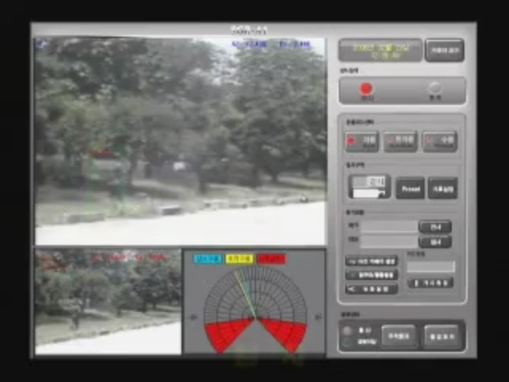
Machine Vision (Continued)
Early 2000s : It started simple
Computers could only detect shapes, edges, and colors
Everything was manually coded, like teaching a robot how to “see” step by step
2010s : It got smart with deep learning
New tech helped machines learn from images instead of being told what to look for
They could now spot animals, people, cars
2015 - 2020s : Machine Vision for all
Tensorflow (2015)
PyTorch (2016)
Open-Source Libraries for Machine vision

Slide 7
TensorFlow

Slide 8
What is TensorFlow?
“An end-to-end platform for machine learning ” – Google
An Open-Source ML framework that provides tools and libraries to build and train other ML models.
Used in Image Recognition, natural image processing etc.

Slide 9
Tensorflow continued
In this session, we will be implementing a model from TensorFlow to detect a live feed from your webcam.
It will detect typically a person, a cat etc.

Slide 10

Real-Time Object Detection

Slide 11
Implementing Tensorflow Object Detection from your Webcam
Project based off https://github.com/Yonas650/Real-Time-Object-Detection
Uses a SSD MobileNet V2 FPNLite 320x320 model in Open CV
SSD – Single Shot Detector
FPN – Feature Pyramid Network
Using 320x320 to reduce CPU / GPU Load

Slide 12
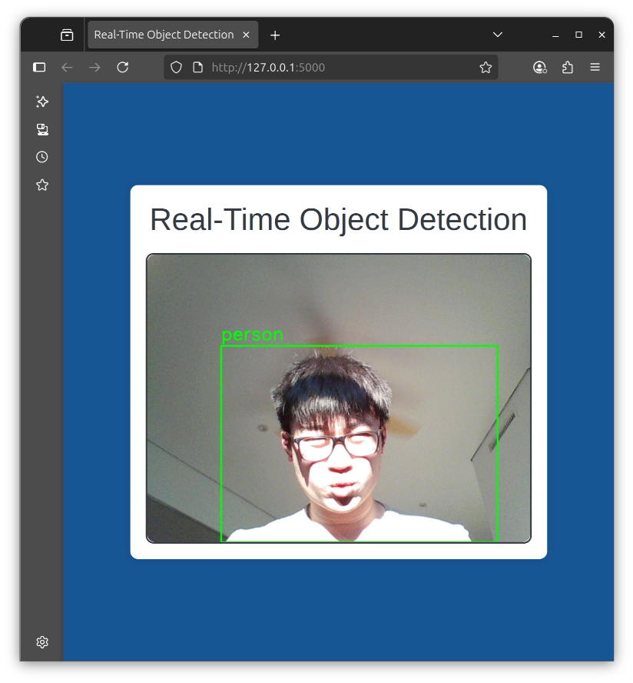
Open CV
Open-Source Python Library for computer vision
Draws the boxes around an image , Helps with labels and processing webcam feed.

Slide 13
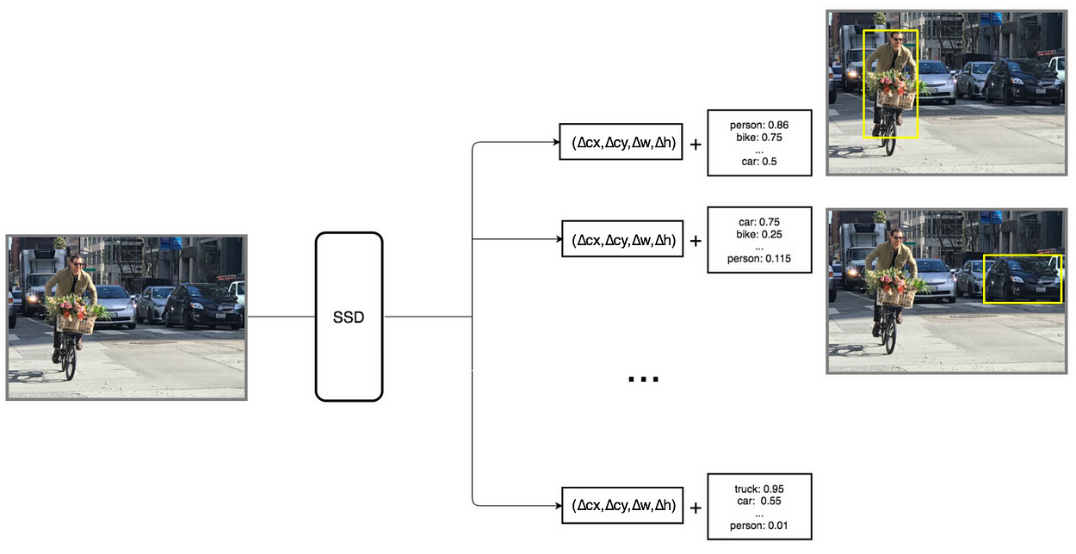
SSD – Single Shot Detector
ML Model that detects Multiple objects in a single run.
Computationally cheaper than its alternatives.
Downside – Less accurate than its alternatives.
🧠 How it works (simple version):
Splits the image into parts
Checks each part for objects, all at once
Gives you boxes + labels in real-time
Image from Medium.com

Slide 14
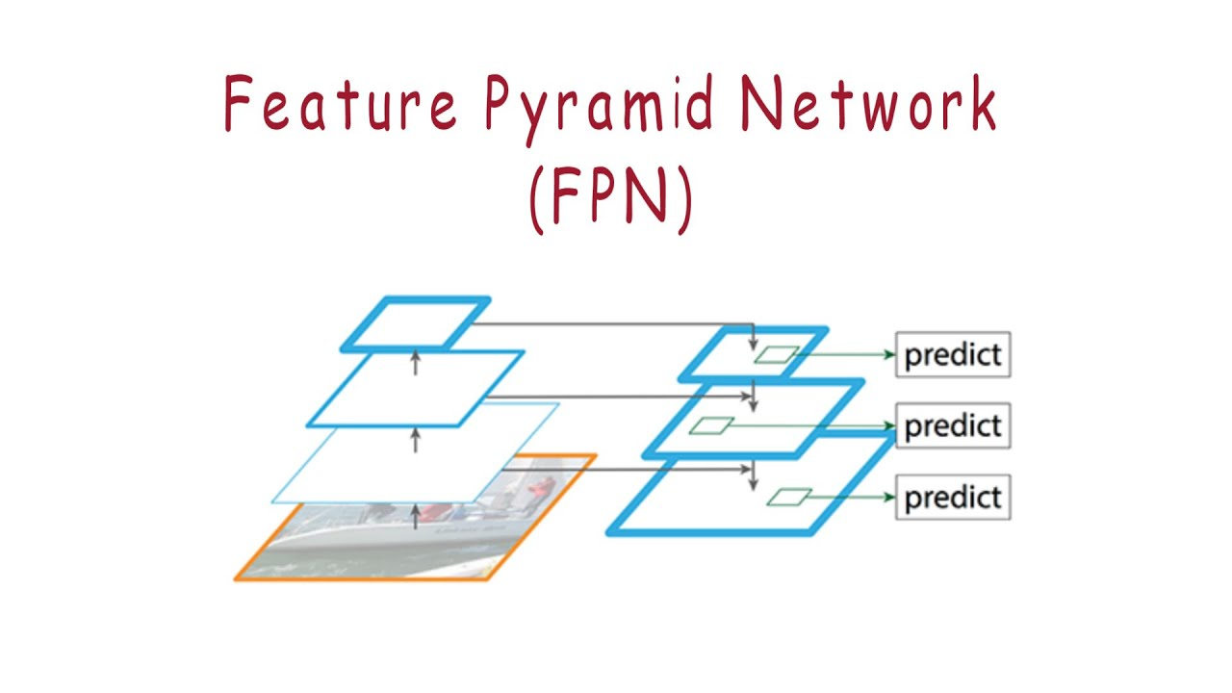
FPN – Feature Pyramid Network
A design trick for improving object detection — especially for small things in big images.
Used for images with perspective
Looks at images in layers
Image from youtube.com

Slide 15
References
Paglen, T. (2017, September 15). You're being watched: Trevor Paglen on how machine-made images are asserting power over society. Artspace. https://www.artspace.com/magazine/interviews_features/qa/qa-trevor-paglen-on-how-machine-made-images-are-asserting-power-over-society-54992
Szeliski, R. (2011). Computer vision: Algorithms and applications. Springer. https://szeliski.org/Book
OpenCV Official WebsiteOpenCV. (n.d.). OpenCV. https://opencv.org/
SSD – Single Shot Detector (Blog Post by Jonathan Hui)Hui, J. (2018, December 28). SSD object detection: Single shot multibox detector for real-time processing. Medium. https://jonathan-hui.medium.com/ssd-object-detection-single-shot-multibox-detector-for-real-time-processing-9bd8deac0e06
FPN – Feature Pyramid Network (Blog Post by Amit Kumar)Kumar, A. (2020, September 20). FPN explained: Feature pyramid network. Medium. https://medium.com/@amit25173/fpn-explained-feature-pyramid-network-7c0f65ea8f8b

Slide 16

Project time!!!
Tutorial Sheet https://github.com/HalcyonEcho/Workshops Original Code by https://github.com/Yonas650/Real-Time-Object-Detection

